Slide 1
WHERE TO START A NEW CAFÉ IN BANGKOK?

Slide 2
INTRODUCTION AND PROBLEMS
1.1 Introduction
It a little dream for many people to have their own small cozy café. For over the past decade, the number of cafés in Bangkok has been growing continuously due to many reasons and, surely, one of them is increasing in demand from both Thai and foreigners. As Bangkok is a capital city of Thailand which has been one of the most desired holiday destinations for many tourists. Moreover, Bangkok has becoming a centre of many multinational organizations so the number of expats is increasing as well.
Apart from the number of increasing tourists and expats, the domestic demand has also been increasing as Thai people enjoy spending their time in a cozy and iconic atmosphere. Some cafés position themselves as a co-working space to encourage people to come in and spend times working in their cafés.

Slide 3
INTRODUCTION AND PROBLEMS
1.2 Problem
Despite the increasing in the demand, many entrepreneurs have seen the opportunities and tried to capitalise it but many has failed. From the opinion of many entrepreneurs, one of the important keys to success in this business is to get the right “location”. Time after time when entrepreneurs quit their jobs and followed their dream blindfoldedly; choose the location which match their personal preference without any research or rational data to back up the decision. For example, an entrepreneur might consider their home area to be a perfect location because he or she assumes that it is a convenient location and there is a lot of demand because there are people traffic in the area. Nonetheless, it might not be the case. Consequently, the businesses did not pan out in the way that they wanted it to be. Thus, without the right location, the dream café could turn in to a nightmare.

Slide 4
METHODOLOGY
This study will begin by making assumptions then acquiring needed data and finally analyse the data to get information to support the assumptions.
2.1 Assumption
Let’s assume that the new café that is about to open is targeting tourists and the perfect location is an area that there will be some tourists with not too intense competitions. Hence, an area which has some attractions but there are not many café would be a perfect location.
2.2 Data
The data needed for this analysis can be acquired from Foursquare via Foursquare API. The example of data that is needed could be the number of cafes and attractions in Bangkok.
2.3 Analysing Data
We will try a couple methods to find a perfect location. Firstly, we will use K-Cluster to group the number of cafes to see where the attractions and cafes are clustered the most. Secondly, we use simple numerical operation to see which area has lowest competition by comparing the number of attractions and cafes.

Slide 5
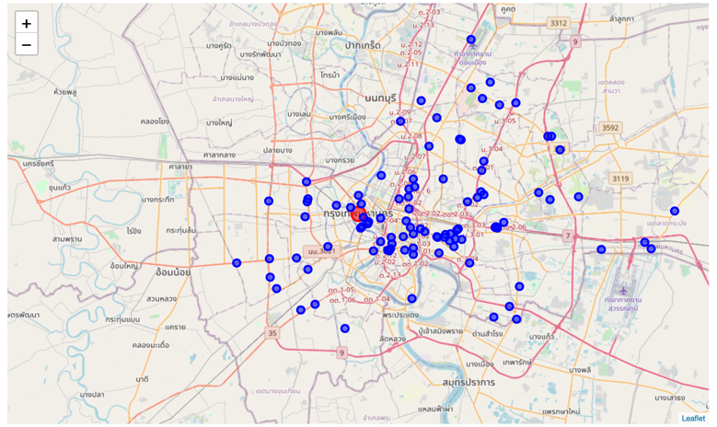
THE MODELS
First, let’s see how where the recommended cafés are in the map of Bangkok. We can see that the cafes are more clustered in the centre of Bangkok than in the suburb area.
Locations of Foursquare Recommended Cafes in Bangkok.

Slide 6
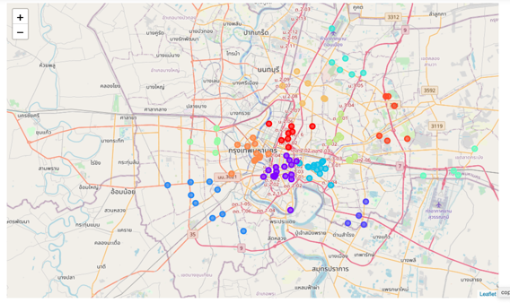
THE MODELS
Then, we can use the k-cluster to segment the cafés by its coordinates. The result from the model is the following figure. In this model, the number of K is 12
Clusters of Foursquare Recommended Cafes in Bangkok.

Slide 7
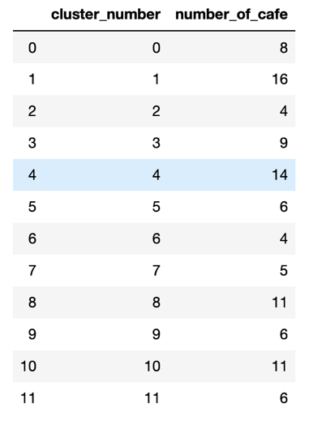
THE MODELS
To be understand each cluster more clearly. Take a look at the following table, we will see the number of cafes in each cluster so we know which clusters have higher number of cafes. Furthermore, we can see the list of cafes in each cluster as well.
Number Of Cafes In Each Cluster.

Slide 8
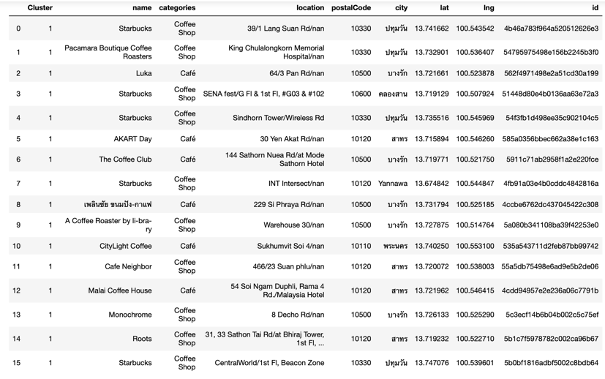
THE MODELS
List of Foursquare Recommended Cafes in Cluster 1

Slide 9
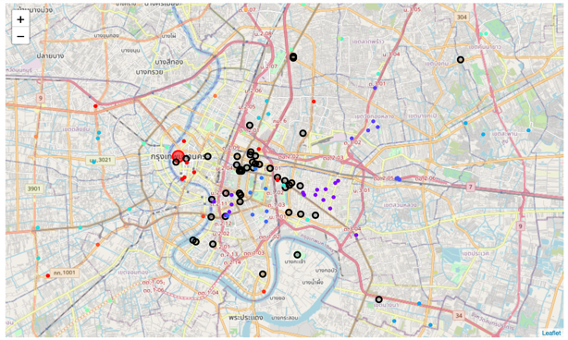
THE MODELS
We can repeat the process and also see the locations and clusters of the attractions in Bangkok. In the following figure, you will see the location of attractions and cafes in the same map and we can visually identify the area that has many attractions but less cafes because it is the intention of this study. A big circle with black outline represents an attraction while the small circles represent cafes.
Locations of Foursquare Recommended Cafes and Attractions in Bangkok.

Slide 10
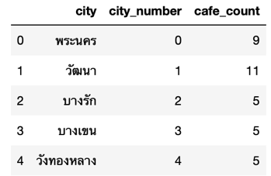
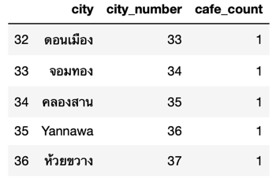
THE MODELS
However, this might not be the best approach to specify the area of where we should look for a space for the new café because it is very difficult to tell where the physical boundary of the cluster is. So, we can use group attractions and cafes according to their district (city) instead. Then we can plot the location of each cafes into a map and each colour represents different city.

Slide 11
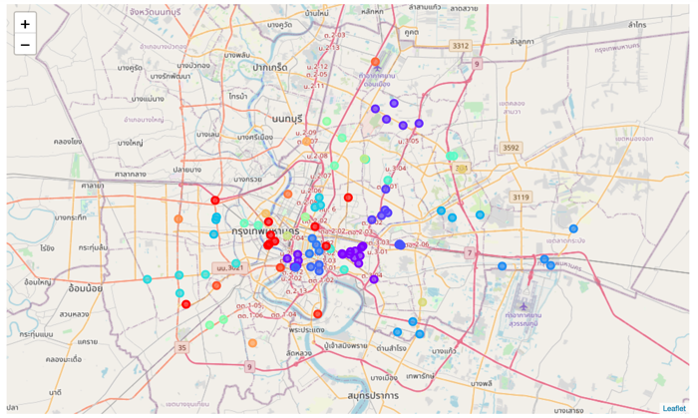
THE MODELS
This is much easier to see where the cafes are clustered, therefore intense competitions but it also means that there are some demands in the area.
Location of Foursquare Recommended Cafes in Bangkok. Segmented by City

Slide 12
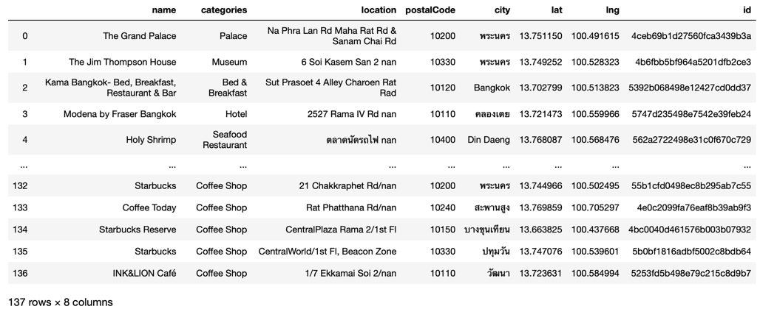
THE MODELS
Next, we can combine the attractions data and cafes data together and group them by district.
List of Foursquare Recommended Cafes and Attractions in Bangkok

Slide 13
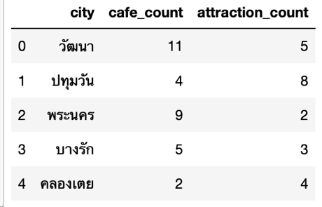
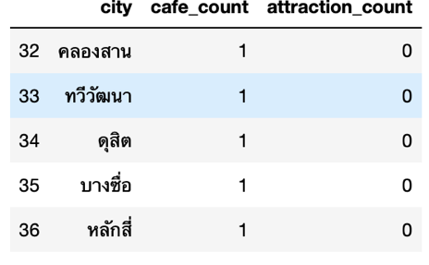
THE MODELS
Next, we can combine the attractions data and cafes data together and group them by district.

Slide 14
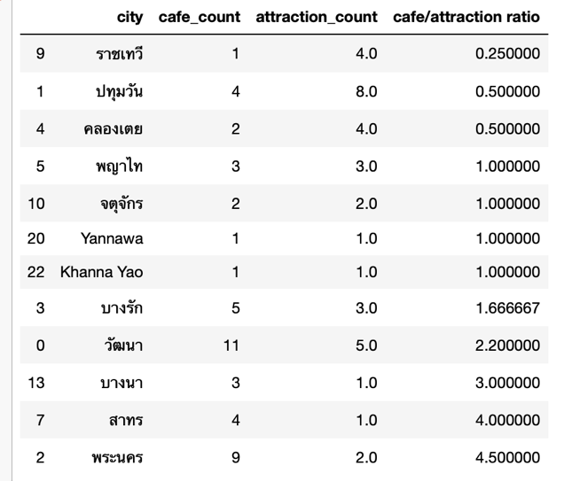
THE RESULT
Since we assume that the new café that is about to open is targeting tourists, as mentioned earlier. We will filter out any city that has no attraction sites at all from the table because it implies that there will be n tourists to visit the area. Then we can use the number of cafes divide by the number of attractions to get the café to attraction ratio of each city.
So, we can conclude that Ratchathewi (ราชเทวี) is the most interesting location to open a new café because it has upto 4 recommended attractions with only 1 recommended café, as of this moment. Thus, we can assume that there will be some tourists visit the attractions but the number of cafes in the area in relatively low and we can open a new one and still have a chance to be successful.

Slide 15
SUGGESTION FOR FURTHER STUDY
The model can be improved by take into the account of number of check-in and rating of each attraction instead of using only the number of sites.

Slide 16
THANK YOU

